Slide 1



Areas of interest/contributions to ANNEX 68
Subtask 2 : Pollutant loads in buildings
Presentation of PANDORA
Marc Abadie, Patrice Blondeau, Francis Allard
University of La Rochelle (ULR), France
36th AIVC conference
Effective ventilation in high performance buildings
IEA EBC Annex 68 Design and Operational Strategies for High IAQ in Low Energy Buildings
September 23 – 24, 2015

Slide 2
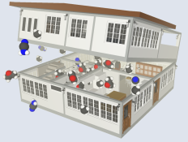
PANDORA
PANDORA: A comPilAtion of iNDoOR Air pollutant emissions
  Database: emission rates of both gaseous and particulate pollutants from :
    Occupants and Occupant Activities
    Cleaning Products and Air Fresheners
    Construction and Decoration Materials
    Furniture
    Heating and Cooking Appliances
    Electrical Equipment
    Others
  Developed by LaSIE (University of La Rochelle) since 2009
  A limited version of PANDORA is available at:
  http://lasie.univ-larochelle.fr/PANDORA-A-comPilAtion-of-iNDoOR
2

Slide 3
Emission rates
Definition of Emission Rates:
  Gaseous pollutant:
    Pollutant mass per time, or
    Pollutant mass per time per surface area for materials, or
    Pollutant mass per source unit for occupant activities such as the use of printers, copy machines, smoking cigarette…, or
    Pollutant mass per combustible mass or energy units for combustion products.
  Particulate pollutant:
    Particle number per time unit per particle size, and
    Particle density.
3

Slide 4
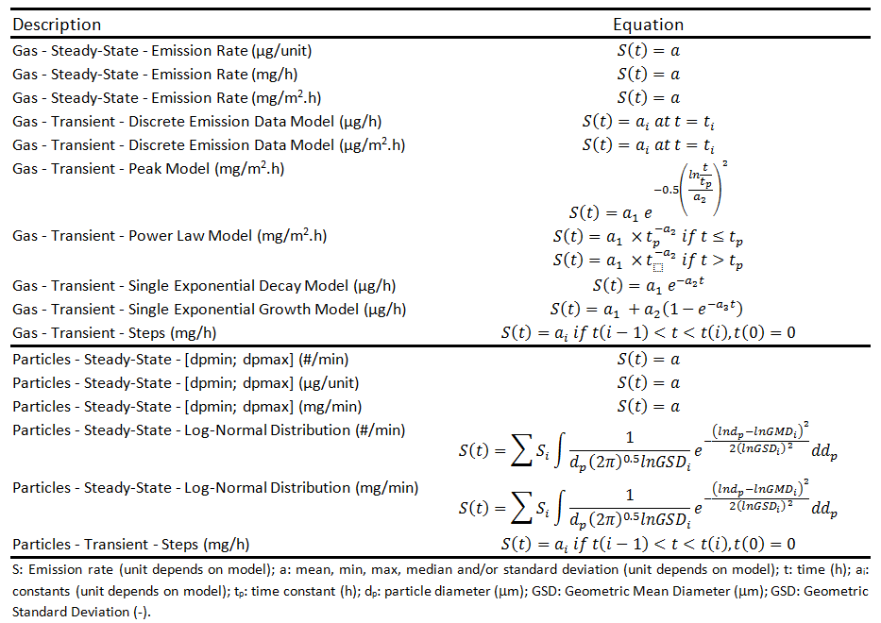
Emission rates
Implemented Emission Models:
4

Slide 5
Basic structure
Category
Global type
Type
Contaminant
Occupants and Occupant Activities
Wooden table
Acetaldehyde
Wooden locker
Formaldehyde
Cleaning Products and Air Fresheners
Tidying up furniture with
plastic compartments
Hexaldehyde
Chairs
Heating and Cooking Appliances
Foam mattress
Benzene
Tables
Sleeping berth
Toluene
Furniture
Drawers
Children comforter
furniture
Acetone
Daycare Furniture
Construction and Decoration Materials
Wooden chairs
Ethylbenzene
Kitchen Furniture
… (21)
Plactis chairs
Electrical Equipment
Blackboard
Others
5

Slide 6
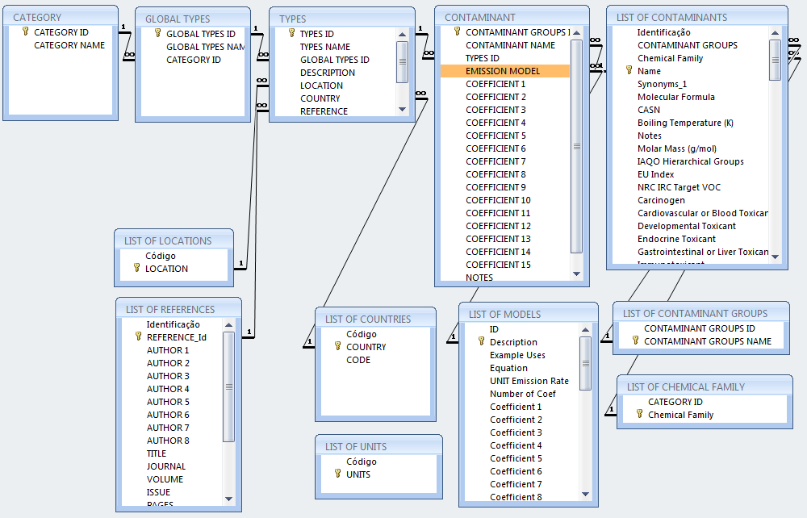
Overall structure
Additional
libraries
6

Slide 7
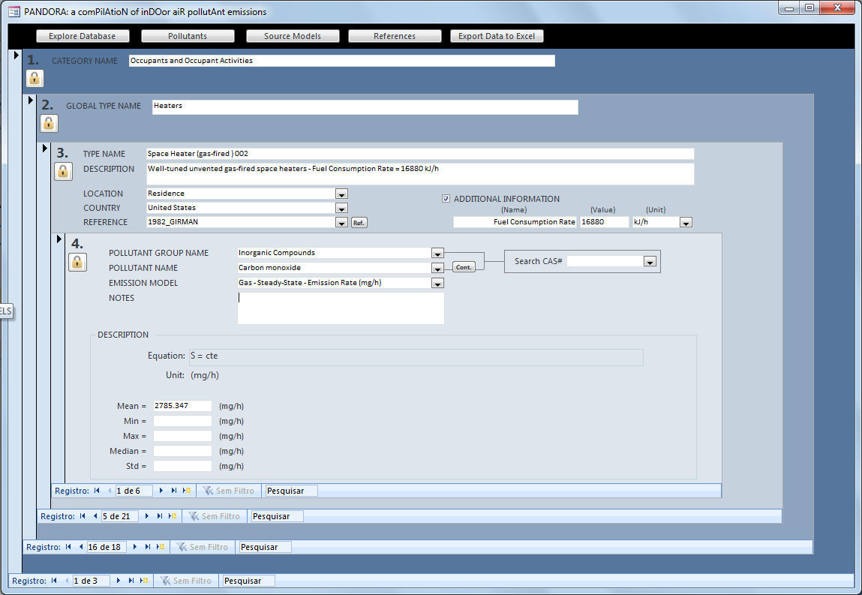
Main interface
7

Slide 8
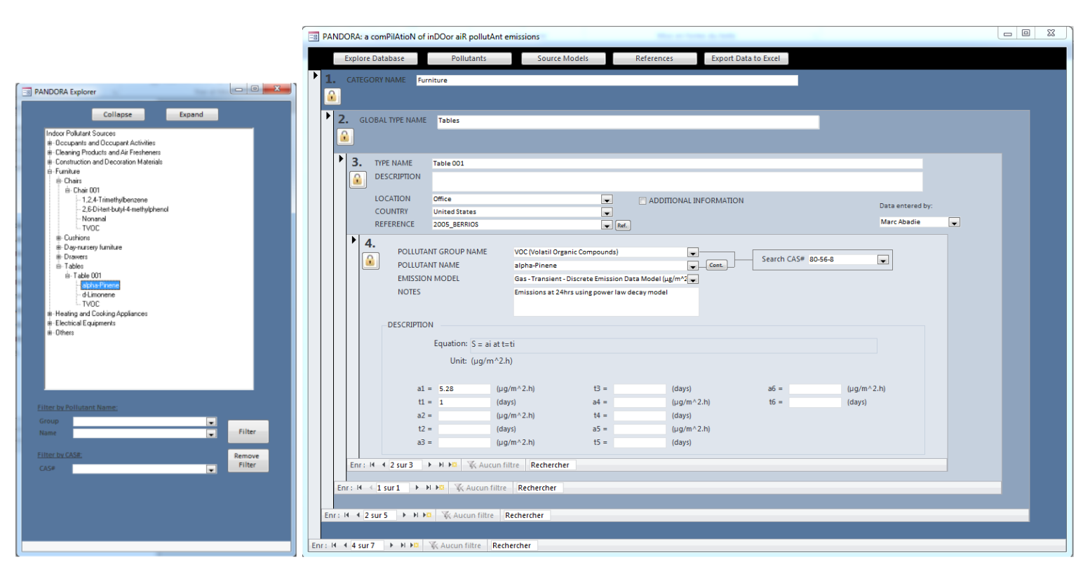
Explorer
8

Slide 9




Origin of the data
2012
MOBAIR
2013
2013
School, Daycare, Bedroom Furniture (20)
ADOQ
2009
Cleaning Products (54)
EPHECT
2009…
1113 ER
Consumer products
290 ER
BUMA
Materials (300)
PANDORE
BUMA+EPHECT=BUMAC
2014
2650 ER
Occupants and Occupant Activities
Cleaning Products and Air Fresheners
Construction and Decoration Materials
Furniture
Heating and Cooking Appliances
Electrical Equipment
Others
2000
OQAI
School supplies and cleaning products (26)
2014
SOPHIE
581 sources (8865 ER)
Materials (108)
518 ER
CSTB
+ HVAC
1983 ER
1999
Materials (11)
1999
Journal
Articles
40%
157 ER
DB US-EPA
MEDB-IAQ
Materials (78) + occupant
activities
Materials (69)
Conference
Papers
10%
800 ER
2300 ER
9
ER : Emission Rates

Slide 10
Statistics (July, 2015)
581 sources
8865 emission rates
10

