Slide 1




Definition of a Reference Residential Building Prototype for Evaluating IAQ and Energy Efficiency Strategies
France
Marc Abadie
LaSIE - University of La Rochelle, La Rochelle, France
IEA EBC Annex 68

Slide 2
Contents
Definition of the reference house
  Floor Plan
  Envelope
  Space Heating, DWH and Ventilation
  French low-energy building regulation (RT2012)
  Energy consumption
Indoor Air Quality
2

Slide 3
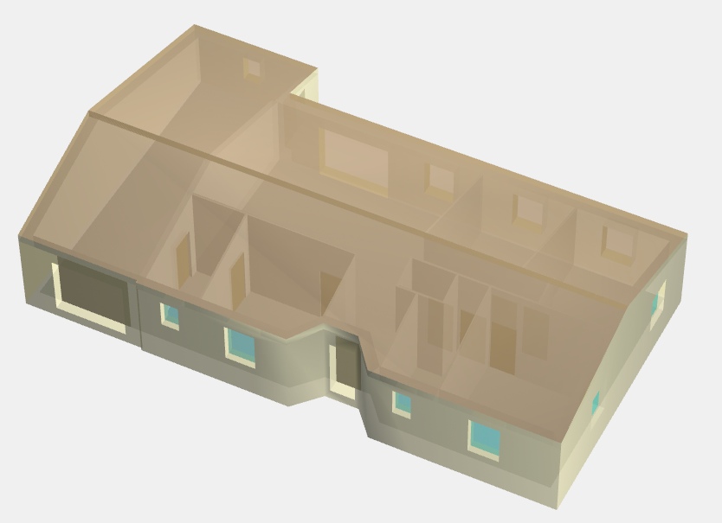
Reference House for France
Description:
  Floor Area: 100 m² (heated area)
  Ceiling Height: 2.50 m
  Total Volume: 250 m³
  1 dining/living room
  3 bedrooms
  1 kitchen
  1 bathroom
  1 WC
  1 cellar
  1 garage (unheated, 37 m²)
Location: La Rochelle (France)
3

Slide 4
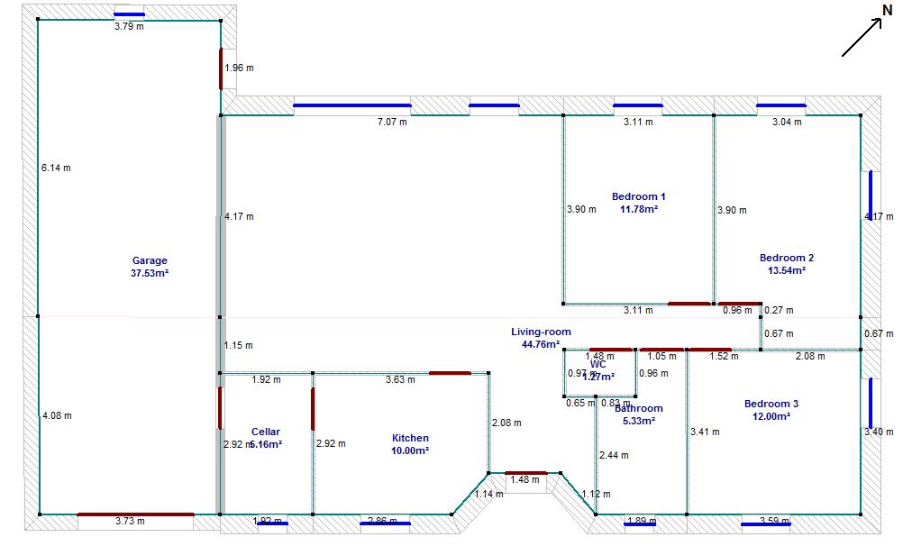
Floor Plan
4

Slide 5
Envelope
Insulation
Attic
40
Cement
Gypsum board
1.3
Concrete blocks
Insulation
Wood panel
Double-glazing windows
4-12-4, Argon
Low emissivity
Outdoor
Indoor
Concrete slab
Insulation
1.5
20
20
1.3
20
20
Ground
5
All dimensions are in cm

Slide 6
Space heating, DHW and ventilation
Space Heating:
  Emission: low-temperature radiators (35°C, ΔT=5°C)
  Generation: heat pump with COP: 3.1 to 5.0 (outdoor air: -7 to 7°C)
DHW:
  Generation: heat pump with COP = 3.59 (outdoor air: 7°C)
  Hot water tank: 290 l (loss: 2.054 W/K)
Ventilation #1:
  Mechanical exhaust ventilation (humidity control)
  Equivalent constant airflow: 75.9 m³/h
Ventilation #2:
  Mechanical balanced ventilation with heat recovery (93%)
  Equivalent constant airflow: 123.1 m³/h
6

Slide 7
French low-energy building regulation (RT2012)
Three main requirements:
  Envelope of the building without considering the HVAC system and other technical facilities. Such features are specified with the Bbio Factor (bioclimatic needs factor) <= Bbio_{max}
  Maximum permitted annual consumption of primary Energy of the building taking into account performances of HVAC system, DHW production and, if any, artificial lighting through the Cep factor
  <= Cep_{max} (kWh_{PE}/m².year)
  Thermal comfort in summer based on the compliance with a maximum comfort calculated temperature Tic <= Tic_{réf}
Complementary prescriptive requirements: envelope airtightness, window area (natural lighting), cold bridges, 1 renewable energy at least (solar PV, heating, biomass... and heat pumps)
7

Slide 8
French low-energy building regulation (RT2012)
Calculations done with the RT2012 engine:
  Building Energy Simulation Software (software: Perrenoud)
  Limitations: the user can not changed the following inputs
    Standard schedules: occupancy, set point temperature, ventilation airflow, lighting (1.4 W/m²) and hot water demand.
    Heat loads:
      Occupants:
        Activity: 90 W and 0.055 kg_{water vapour}/h
        Sleep: 63 W and 0.0385 kg_{water vapour}/h
      Equipment:
        Activity: 5.7 W/m²
        Sleep-unoccupied: 1.1 W/m²
Reference house – Ventilation #1 (EXHAUST):
  Bbio = 51.9 <= Bbio_{max} = 61.2
  Cep = 42.1 kWh_{PE}/m².year <= Cep_{max} = 51.2 kWh_{PE}/m².year
  Tic = 29.8°C <= Tic_{ref} = 32.5°C
Reference house – Ventilation #2 (BALANCED):
  Bbio = 5.19 <= Bbio_{max} = 61.2
  Cep = 50.7 kWh_{PE}/m².year <= Cep_{max} = 51.2 kWh_{PE}/m².year
  Tic = 29.7°C <= Tic_{ref} = 32.4°C
8

Slide 9
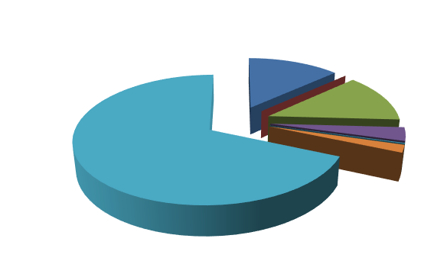
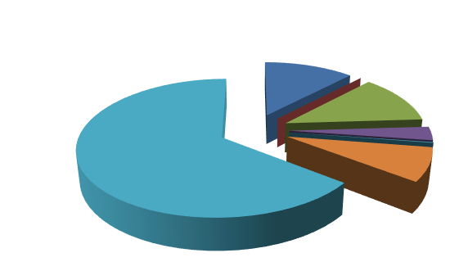
Energy consumption
 |  | kWh/year | kWh/m².year | MJ/year | MJ/m².year
Heating | EXH | 794 | 7.9 | 2857 | 29
 | BAL | 771 | 7.7 | 2774 | 28
Cooling | EXH/BAL | 0 | 0 | 0 | 0
DHW | EXH/BAL | 782 | 8 | 2815 | 28
Lighting | EXH/BAL | 207 | 2 | 745 | 7
Pumps | EXH/BAL | 12 | 0 | 41 | 0
Fans | EXH | 115 | 1.2 | 414 | 4
 | BAL | 506 | 5.1 | 1822 | 18
Total | EXH | 1886 | 18.9 | 6790 | 68
 | BAL | 2254 | 22.5 | 8114 | 81
+Interior Equipment | EXH/BAL | 4112 | 41 | 14804 | 148
Total | EXH | 5998 | 60.0 | 21593 | 216
 | BAL | 6366 | 63.7 | 22918 | 229
Considered surface area: heated zone (garage excluded), final energy (not primary energy)
Ventilation #1
(EXHAUST)
Ventilation #2
(BALANCE)
9

Slide 10

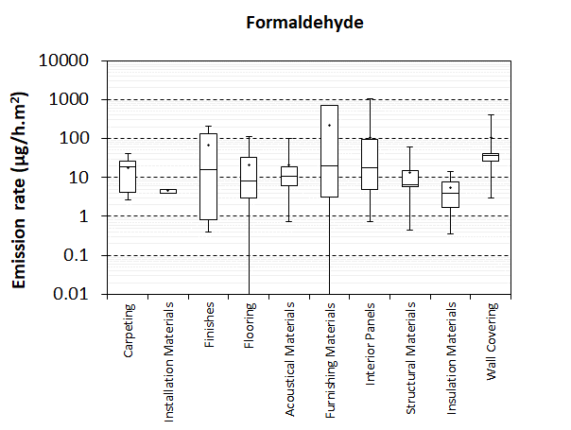
Indoor Air Quality
Emission Rates for the Reference House based on the:
  Labeling system: approach similar to Liu et al. document (A+ higher value)
  Pandora database*:
  *http://lasie.univ-larochelle.fr/PANDORA-A-comPilAtion-of-iNDoOR
10

Slide 11
Indoor Air Quality
Guidelines or label schemes for building materials
VOC limitations of indoor decorating and refurbishing materials in France
 | C | B | A | A+
Formaldehyde | >120 | <120 | <60 | <10
Acetaldehyde | >400 | <400 | <300 | <200
Toluene | >600 | <600 | <450 | <300
Tetrachloroethylene | >500 | <500 | <350 | <250
Xylene | >400 | <400 | <300 | <200
1,2,4-Trimethylbenzene | >2000 | <2000 | <1500 | <1000
1,4-Dichlorobenzene | >120 | <120 | <90 | <60
Ethylbenzene | >1500 | <1500 | <1000 | <750
2-Butoxyethanol | >2000 | <2000 | <1500 | <1000
Styrene | >500 | <500 | <350 | <250
COVT | >2000 | <2000 | <1500 | <1000
Test cell : V=30 m³, n=0.5 vol/h,
T=23°C, RH=50%
 | Load Factor (L = S/V) (m²/m³) | Area (m²)
Floor | 0,4 | 12
Ceiling | 0,4 | 12
1 Door | 0.05 | 1.6
1 Window | 0.07 | 2
Wall (without window/door) | 1 | 31,4
Sealant | 0.007 | 0,2
Concentration at 28th day in µg/m³
11

Slide 12
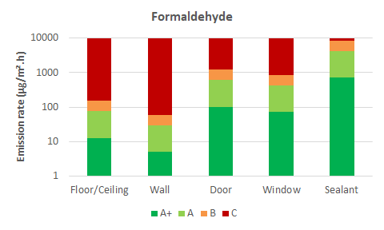
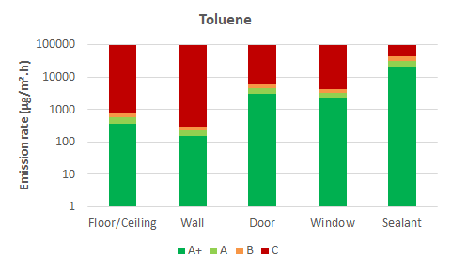
Indoor Air Quality
Guidelines or label schemes for building materials
VOC limitations of indoor decorating and refurbishing materials in France
12

Slide 13
Indoor Air Quality
Labeling system: approach similar to Liu et al. document (higher value for A+, each material should contribute no more than 50% of the total pollution load for a given compound)
Label A+ | Area (m²) | Nb of Face | Emission Surface (m²) | Load Factor (m²/m³) | E Formaldehyde (µg/m².h) | E Toluene (µg/m².h) | E Formaldehyde (µg/h) | E Toluene (µg/h)
Flat roof with unused attic | 100.0 | 1 | 100.0 | 0.4 | 6.25 | 188 | 625 | 18750
External Wall | 96.3 | 1 | 96.3 | 1 | 2.50 | 75 | 241 | 7220
Floor | 100.0 | 1 | 100.0 | 0.4 | 6.25 | 188 | 625 | 18750
Exterior Door | 3.5 | 1 | 3.5 | 0.05 | 50.00 | 1500 | 173 | 5202
Internal Walls | 84.7 | 2 | 169.5 | 1 | 2.50 | 75 | 424 | 12711
Vertical glazing | 8.5 | 1 | 8.5 | 0.07 | 35.71 | 1071 | 304 | 9118
Interior Door | 12.1 | 2 | 24.3 | 0.05 | 50.00 | 1500 | 1214 | 36414
Closet doors
Kitchen Cabinets
 |  |  |  |  |  | Sum | 3605 | 108165
 | Formaldehyde | Toluene
ELV (µg/m³) | 10 | 300 |  |  |  | Surface emission factor | 50%
 | Q (m³/h) | ACH (/h) |  |  |  | Ca (µg/m³) | Formaldehyde | Toluene
Ventilation #1 (EXHAUST) | 75.9 | 0.30 |  |  |  | Ventilation #1 (EXHAUST) | 47.5 | 1425.1
Ventilation #2 (BALANCED) | 123.1 | 0.49 |  |  |  | Ventilation #2 (BALANCED) | 29.3 | 878.7
13

Slide 14
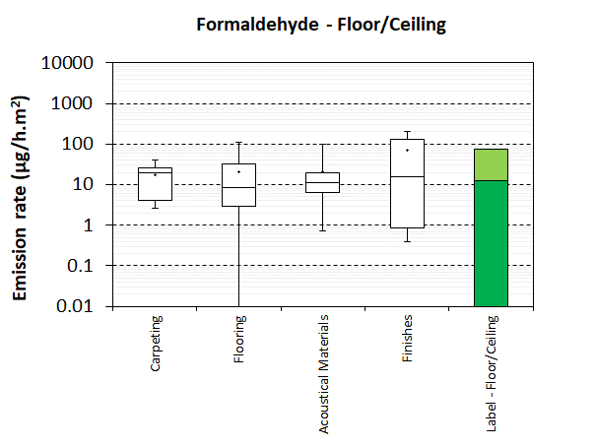
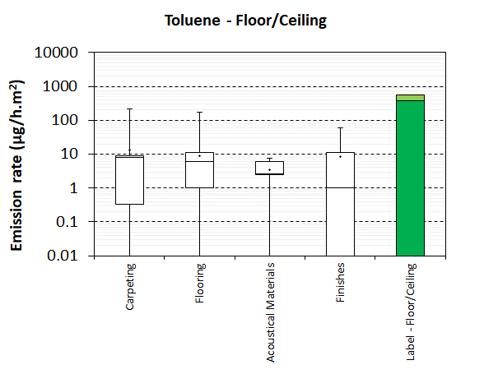
Indoor Air Quality
2. Pandora database:
14

Slide 15
Indoor Air Quality
2. Pandora database: median values and 50% factor
Label A+ | Area (m²) | Nb of Face | Emission Surface (m²) | Load Factor (m²/m³) | E Formaldehyde (µg/m².h) | E Toluene (µg/m².h) | E Formaldehyde (µg/h) | E Toluene (µg/h)
Flat roof with unused attic | 100.0 | 1 | 100.0 | 0.4 | 4.15 | 3.10 | 415 | 310
External Wall | 96.3 | 1 | 96.3 | 1 | 7.73 | 0.50 | 744 | 48
Floor | 100.0 | 1 | 100.0 | 0.4 | 4.15 | 3.10 | 415 | 310
Exterior Door | 3.5 | 1 | 3.5 | 0.05 | 7.73 | 0.50 | 27 | 2
Internal Walls | 84.7 | 2 | 169.5 | 1 | 7.73 | 0.50 | 1309 | 85
Vertical glazing | 8.5 | 1 | 8.5 | 0.07 | 7.73 | 0.50 | 66 | 4
Interior Door | 12.1 | 2 | 24.3 | 0.05 | 7.73 | 0.50 | 188 | 12
Closet doors
Kitchen Cabinets
 |  |  |  |  |  | Sum | 3163 | 771
Median values (µg/m².h) | Formaldehyde | Toluene
Flooring | 8.3 | 6.2 |  |  |  | Surface emission factor | 50%
Finishes | 15.5 | 1.0
 | Q (m³/h) | ACH (/h) |  |  |  | Ca (µg/m³) | Formaldehyde | Toluene
Ventilation #1 (EXHAUST) | 75.9 | 0.30 |  |  |  | Ventilation #1 (EXHAUST) | 41.7 | 10.2
Ventilation #2 (BALANCED) | 123.1 | 0.49 |  |  |  | Ventilation #2 (BALANCED) | 25.7 | 6.3
15

Slide 16
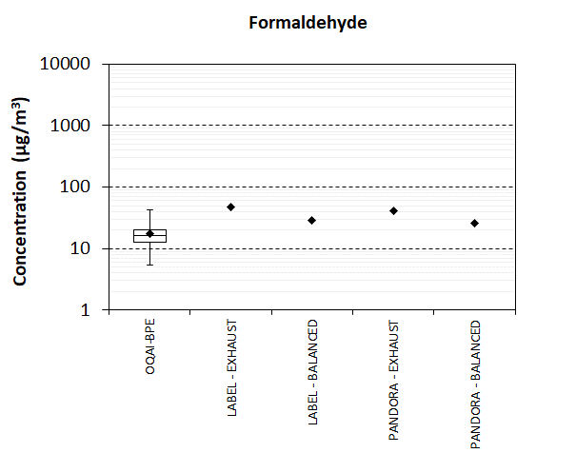
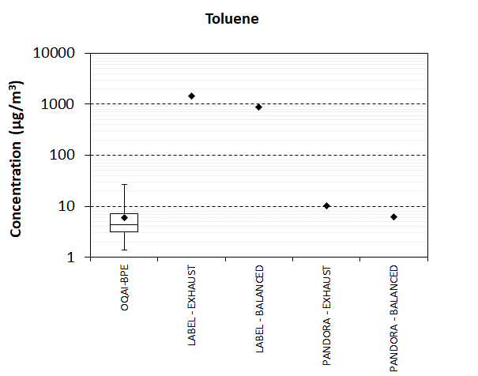
Indoor Air Quality
3. Comparison
16

Slide 17
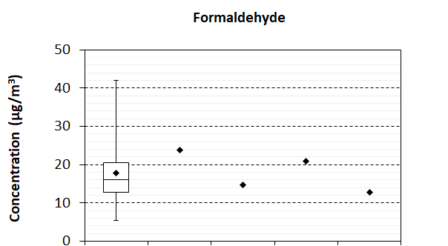
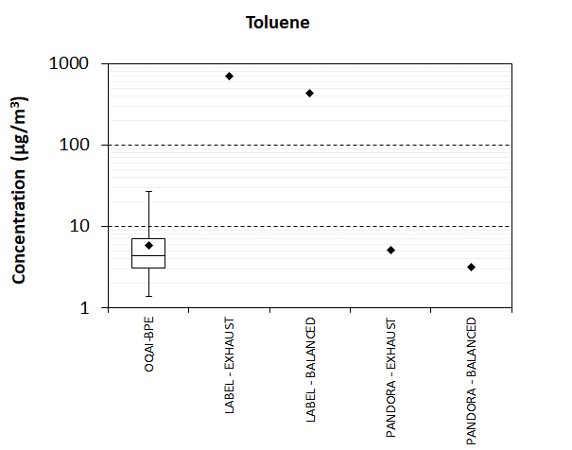
Conclusion
As expected, mechanical balanced ventilation with heat recovery (123.1 m³/h) provides better IAQ than exhaust ventilation with humidity control (75.9 m³/h) with very low energy consumption penalty.
Both approaches (A+ labeling and data from PANDORA) gives similar results for Formaldehyde but the A+ labelling approach fails to predict the order of magnitude for Toluene.
The statement “each material should contribute no more than 50% of the total pollution load for a given compound” should be modified to “… than 25% of the…” when using PANDORA median values.
17

Slide 18


