Slide 1

ANNEX 68 ST 4 Indoor air quality based ventilation strategies
Guangyu Cao
(guangyu.cao@ntnu.no)
Department of Energy and Process Engineering
(21/03/2017, Dresden)

Slide 2

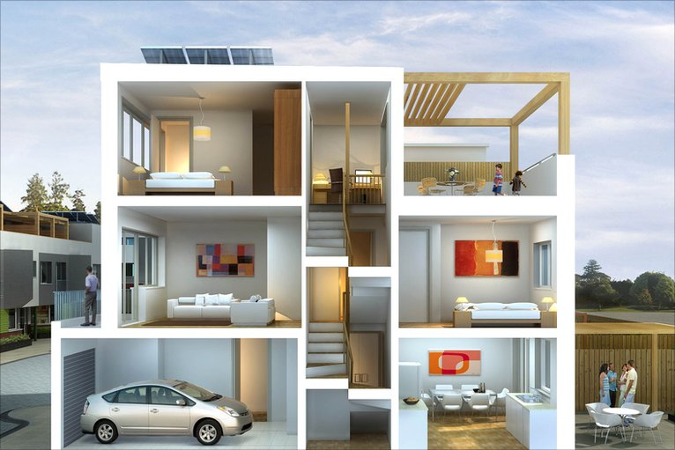
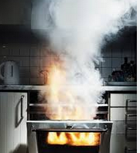

Indoor air quality and potential pollutants
Chemicals released from modern buildings & furnishing materials
From cleaning products: solvents
Pets
Fireplace & wood burning
Biological contaminants
Carbon Monoxide and Nitrogen oxides from vehicles
Radon from foundation
Mold & bacteria

Slide 3
Case 1: Field measurements of indoor particle matter concentration affected by indoor occupants’ activities and outdoor conditions
Maria Justo-Alonso ^{1,*}, Guangyu Cao², Hans Martin Mathisen²
¹ SINTEF Building and Infrastructure, Trondheim, Norway
² Norwegian University of Science and Technology, Trondheim, Norway
*Corresponding email: maria.justo.alonso@sintef.no

Slide 4
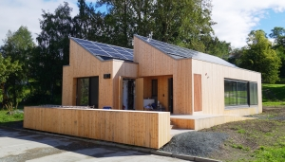
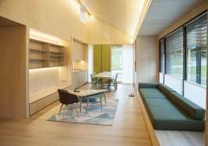
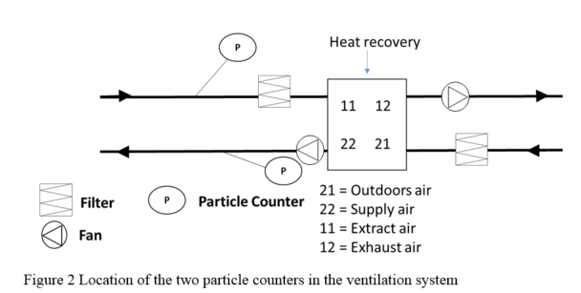
Living Lab
Building physical properties
U-value wall | 0.11 W/m²K 0.10 W/ m²K
U-value floor/roof
U-value windows (south façade) | 0.65 / 0.69 (when ventilated) W/ m²K
U-value windows (north façade) | 0.97 W/ m²K
U-value windows (east-west façade) | 0.80 W/ m²K
U-value skylight | 1.0 W/ m²K
g-value for windows | 0.5-
Air tightness, n50 | 0.5 ach
Notes:
During the measurements, the selected ventilation mode was mechanical ventilation with the supply airflow rate of 330 m³/h and the extraction airflow rate 215 m³/h. The kitchen was equipped with an one-way damper that ensures no overpressure in the house.

Slide 5
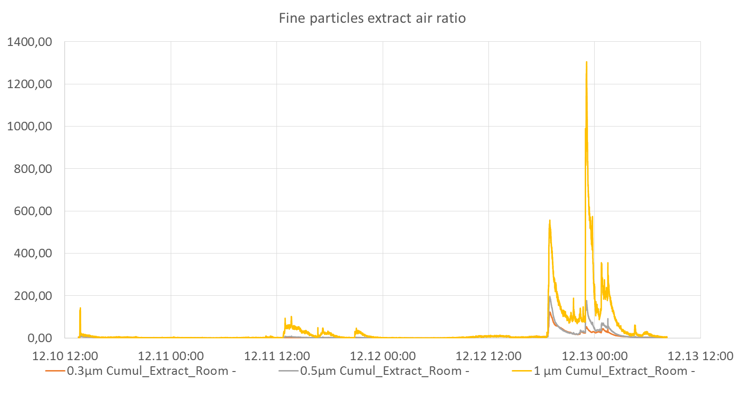
RESULTS
Comparison of the concentration of fine particles (0.3-1μm) in the extract
Notes:
The reference concentration was defined to calculate the ratio of the measured concentrations of the room air and the supply air to the reference concentration, respectively. The reference concentration was the average concentration in the earlier morning of 11th December, from 1.00-2.00am. It assumed that the effects of outdoor traffic conditions and indoor occupants’ activities may be negligible when calculate the reference concentration. The ratio of the measured extract air concentration to the reference concentration is defined as the extract air ratio; the ratio of the measured supply air concentration to the reference concentration is defined as the supply air ratio.

Slide 6
Case 2: Experimental study of indoor air quality in two types of Norwegian houses heated by wood stove
Guangyu Cao^{1,*}, Laurent Georges¹, Øyvind Skreiberg², Morten Seljeskog²
¹Norwegian University of Science and Technology, Trondheim, Norway
²SINTEF Energy Research AS, Trondheim, Norway

Slide 7
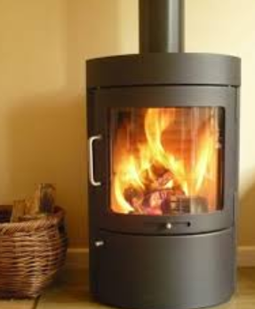
Wood stove and air pollution
– smoke and wood ash?
Carbon monoxide
Fine particulates
VOCs
Nitrogen oxides (NO, NO₂)
Sulfur oxides (SO₂)
Dioxins (POPs)
Furans (C4H4O)
http://des.nh.gov/organization/commissioner/pip/factsheets/ard/documents/ard-36.pdf

Slide 8
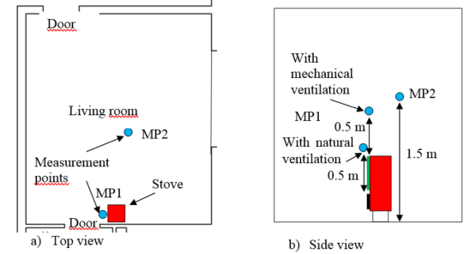
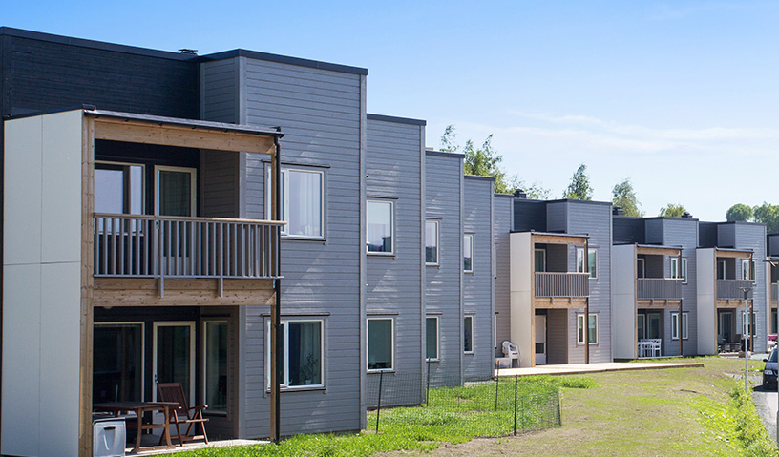
Measured particle concentration in a row house
Built in 2013

Slide 9
TEK’10 – effective from Jan 1st 2012
§ 13-2.Ventilasjon i boenhet
(1) Boenhet skal ha ventilasjon som sikrer en gjennomsnittlig frisklufttilførsel på minimum 1,2 m³ pr. time pr. m² gulvareal når rommene eller boenheten er i bruk og minimum 0,7 m³ pr. time pr. m² gulvareal når rommene eller boenheten ikke er i bruk.
(…minimum fresh air 1.2 and 0.7 m³/ hour per m² floor area when the rooms are in use and not in use, respectively.)
(2) Soverom skal tilføres minimum 26 m³ friskluft pr. time pr. sengeplass når rommet eller boenheten er i bruk.
(A bedroom shall have fresh air at least 26 m³ /hour per person when in use)
(3) Rom som ikke er beregnet for varig opphold skal ha ventilasjon som sikrer 0,7 m³ friskluft pr. time pr. m² gulvareal.
(…minimum fresh air 0.7 m³/ hour per m² floor area when the rooms are not in use.)
https://lovdata.no/dokument/SF/forskrift/2010-03-26-489

Slide 10
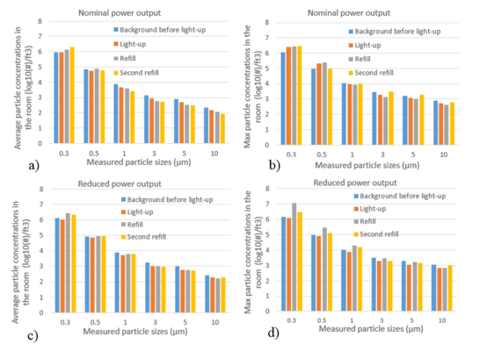
Measurement results

Slide 11
Trends of future ventilation strategies
Demand control ventilation/smart ventilation
  Motion/precense
  CO₂
  Noise
  PM
  …
Local air cleaning:
  local filter and/or
  gas phase air cleaning
  …
Personalized/protected zone ventilation
  better thermal comfort,
  better local IAQ and
  energy saving
  …

Slide 12
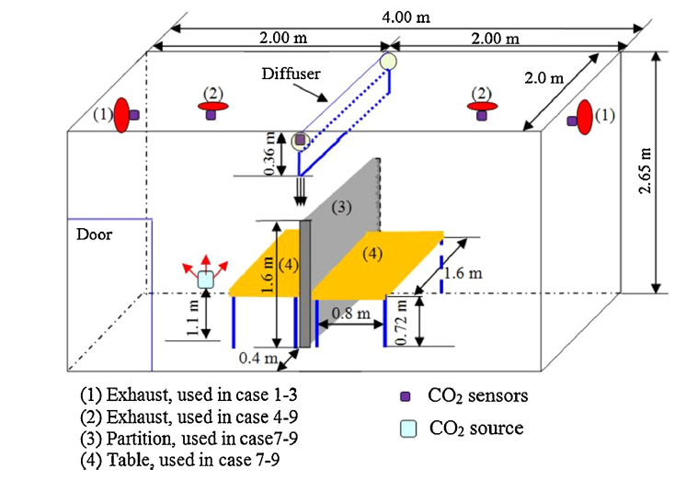
Protected (occupied) zone ventilation (POV/PZV)
Protected occupied zone ventilation (POV/PZV) is a new ventilation method, which separates the indoor space into sub zones by plane jets to protect occupants from various indoor pollutants......

Slide 13
Conclusions of Case 1
The particle concentration of the room air may be affected by both supply air and occupants’ activities.
The uses of candles and the record player may explain the higher concentration of fine particles.
With less occupants and lower level of activities, the concentration of coarse particles may be reduced gradually.
Conclusions of Case 2
Indoor concentration may increase during the lighting up and refilling phase.
The operation of a wood stove may induce more infiltration air through leakages, which may bring particulate matter pollutants indoors.

Slide 14
Conclusions
Indoor air may contain a wide range of pollutants generated both by materials and occupants’ activities.
Ventilation is an effective engineering measure to control indoor air quality, the ventilation strategy should take into account both emission from building materials and occupants’ activities.
Ventilation/airflow rate should be determined by the needs of occupants and the specific requirements of indoor conditions.

