Slide 1
Available Information / Guidelines for residential ventilation systems in Austria
Research projects with documented results for planers/architects
Cascade Ventilation: Planning guide floor plan, design parameters for overflow elem.
Low_vent: Optimized ventilation concepts, ventilation rates, fire safety measures
Luna: Comparison of PH-heating strategies (including air heating)
Sinfonia and 3EnCult: Active overflow principle
Proposed Project: Cost efficient fire safety and volume flow control for central MVHR, early-stage planning aid within designPH
Evaluation of central and semi-central residential ventilation:
Various guides and checklists
Technical Status of residential MVHR:
Examples and common mistakes in planning/realization
ZUKOLÜ (Guides and checklist for proper hygene in MVHR)
… (a number of monitoring projects including IAQ aspects and surveys)
E.g. Detail IAQ comparison 60 low-energy houses with/without MVHR

Slide 2
Available Information / Guidelines for residential ventilation systems in Austria
Standards
ÖNORM H 6038
Controlled mechanical ventilation with HR - Planning, installation, operation and maintenance
Guidelines / Tools / Information for Planers & Architects:
PH planning guides: www.passipedia.org / PHPP
Information platform: www.komfortlüftung.at
  Planning-Guideline for MVHR in MFH
  60 quality criteria for MVHR systems
  Tips for tendering (call for bidding)
  …
Cascade ventilation guide: http://www.phi-ibk.at/luftfuehrung/
Audioguides: xxx
KWL Tool: https://www.enerweb.ch/kwl.html
(ist kommerzielle SW, oder?
To come: 3D early stage planning in designPH

Slide 3
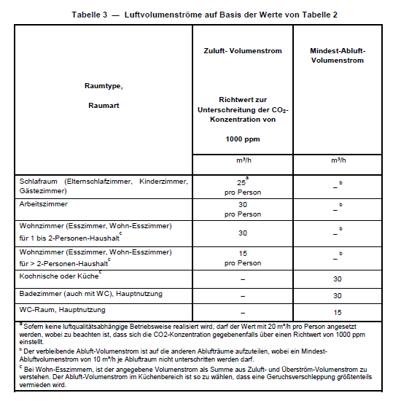
Standard ÖNORM H 6038 (2014)
Controlled residential ventilation including heat recovery
Planning, installation, operation and maintenance
Guidelines on:
Planning and dimensioning
Operation (general)
Vent rates
Components
Installation
Commissioning
<- Input also from UIBK

Slide 4
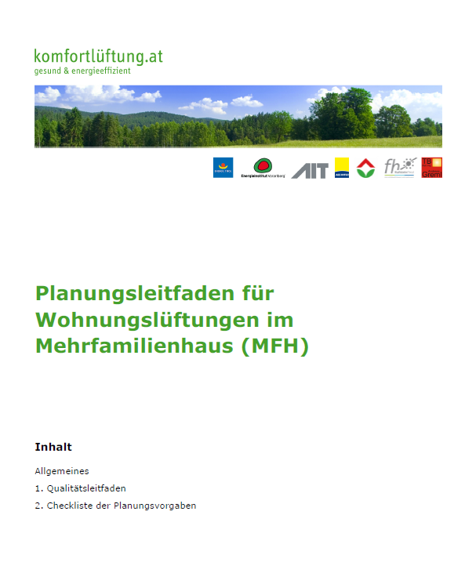

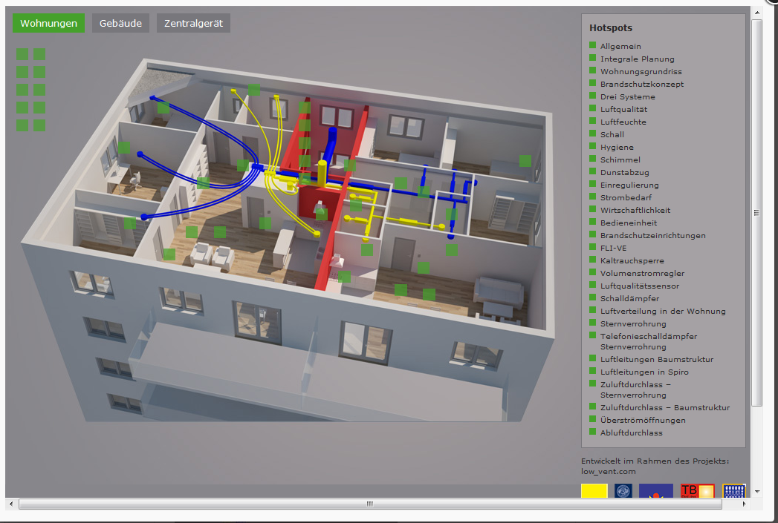
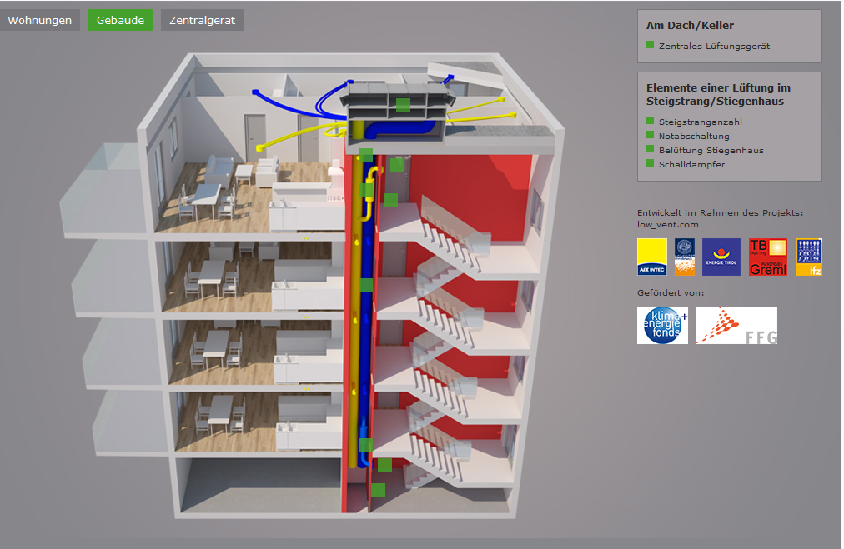
www.komfortlüftung.at
Various brochures, e.g.:
Planning guide for MFH (xx pages)
Hints for tendering
Checklist quality criteria
Various informational brochures for developers, home owners or occupants including visualization

Slide 5
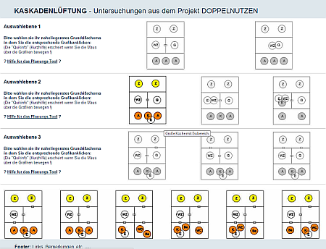
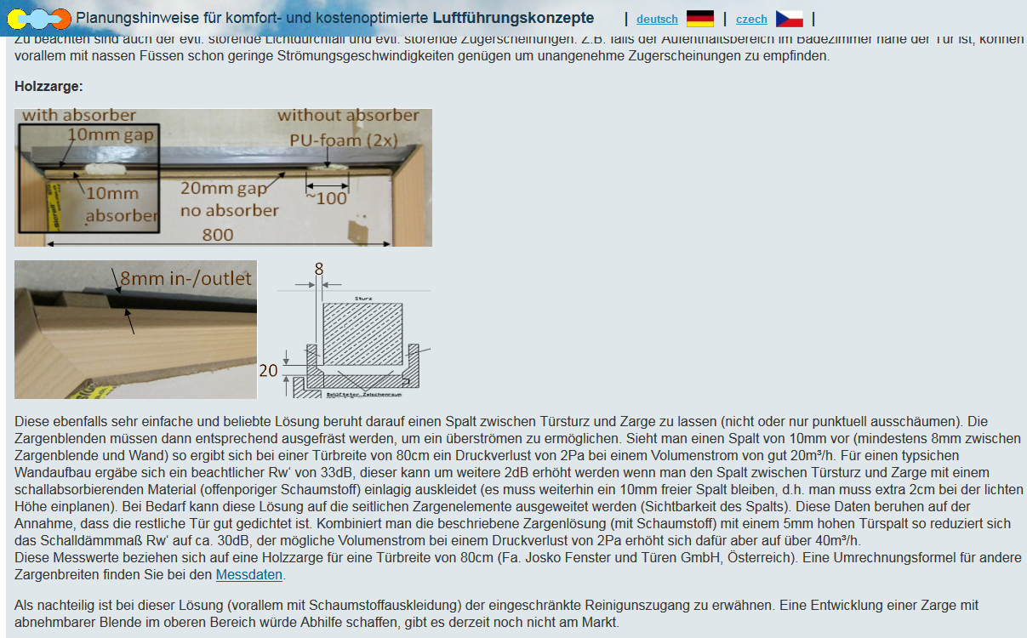
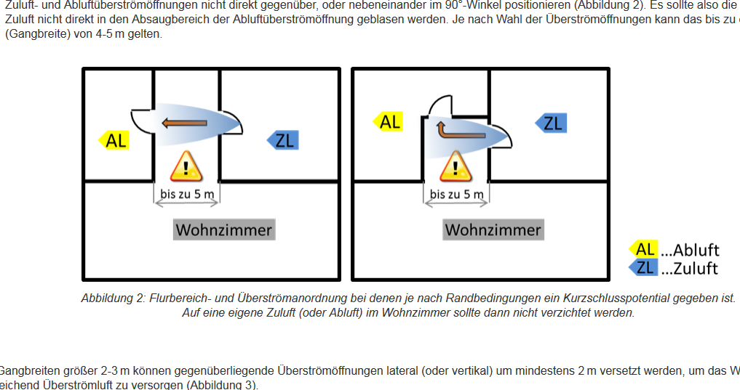
Cascade ventilation online tool
Interactive planning/decision guide for extended cascade ventilation principle
Overview and design parameters of simple, cost efficient overflow solutions
Further information for floor plans with potential risk of short-circuit flow

Slide 6
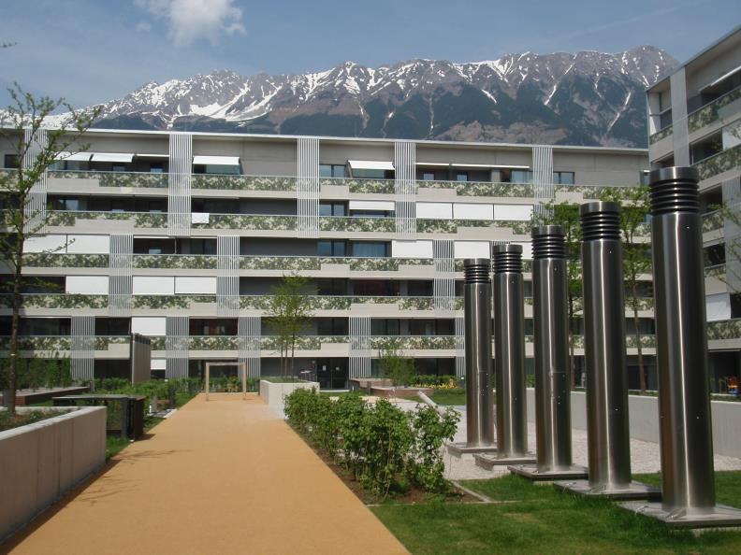
Regional project “Lodenareal”
Monitoring of large PH apartment complex
Source: www.passiv.de
TVOC (Tenax) before move-in
CO2, R.H. & temperature long term monitoring
Notes:
356 PH apartments -> 3 year monitoring and occupant survey
Low vent rate -> Co2 often in IDA3 -> good user rating (no health issue: HEALTH vent)
But numerous complaints (>30%) about dry air (measurement show levels < 30%)
Results show high indoor air temperatures
? Effect of high temp and low RH on TVOC emissions
? How do VOC concentrations evolve (long term, daily) after move-in (furniture, activities) -> future project (Teflon tubes installed)

Slide 7
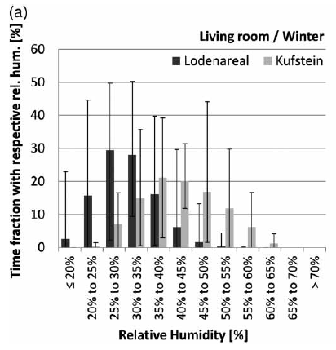
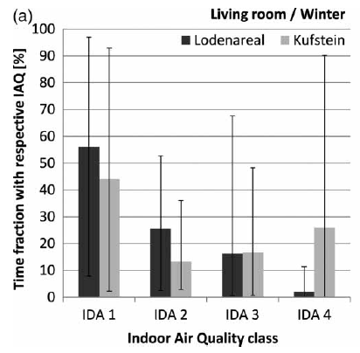
Vgl Lodenareal (mit Lüftung) mit Kufstein (ohne Lüftung)
CO₂-Konzentration über Außenluft [ppm]
Nach
EN 13779
<400 | <600 | <1000 | >1000
Hoch | Mittel | Mäßig | Niedrig
-> Zuluftdilemma: niedrige CO2 vs. Vermeidung von Trockenheit

Slide 8
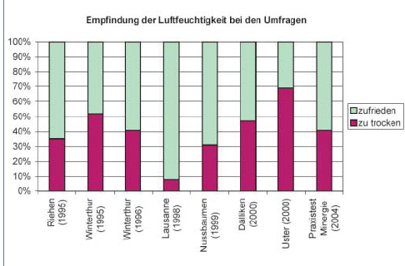
A. Tschui and T. Emmenegger, “Im Winter kommt die Trockenheit,” planer+installateur, vol. 4, pp. 74–75, 2005.

