Slide 1
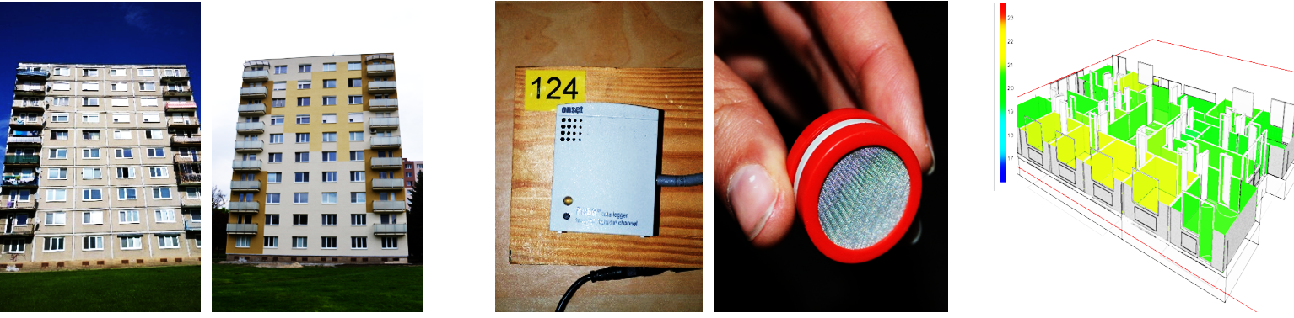

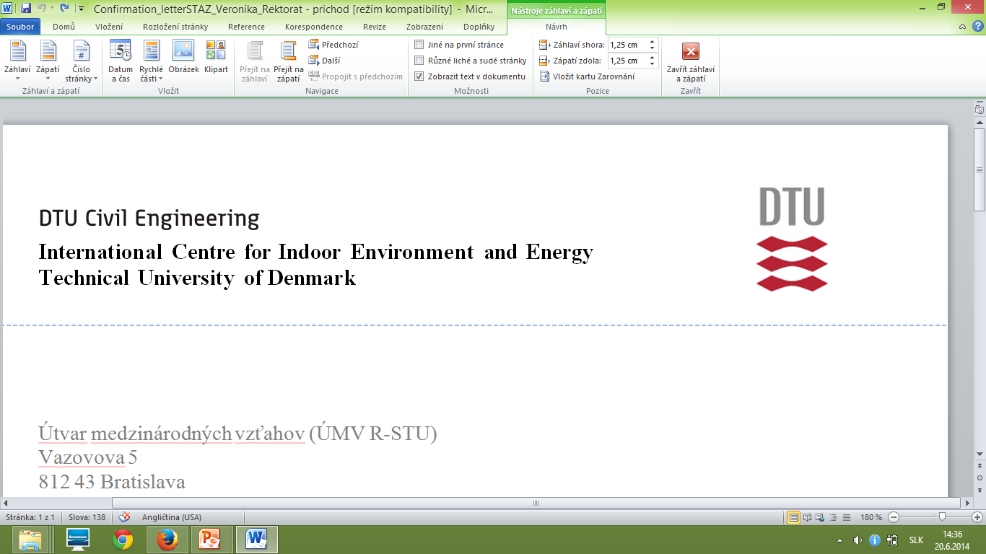
Assessment of indoor environmental quality in residential buildings before and after renovation
Veronika Földváry
1
9th September 2016

Slide 2
INTRODUCTION
MATERIALS AND METHODS
RESULTS
CONCLUSIONS
71.6% of the multifamily residential buildings (built from 1948 to 1990) do not satisfy the current requirements on energy efficiency (Statistical institute, SR).
Slovakia, just as several other Eastern and Central European countries, fails to capitalize on the opportunity to include assessment of IEQ on a nationwide scale.
People spend about 80-90% of their time indoors. Occupant exposure occurring in the residential environment can be substantial:
Health
Performance
IEQ
Well-being
SBS

Slide 3
INTRODUCTION
MATERIALS AND METHODS
RESULTS
CONCLUSIONS
Objectives of the study
The study seeks to evaluate the impact of energy retrofits of multifamily dwellings on IEQ. In relation to building retrofit measures, the main objectives were:
To evaluate the alterations in basic parameters of IEQ, such as T, RH and CO2 concentration, and in AERs and pollutant concentrations indoors. .
To evaluate the alterations in perceived air quality, SBS symptoms and occupants´ behaviour.
To propose improved ventilation strategy for naturally ventilated residential buildings.
To provide recommendations for policy makers, engineers and the public based on outcomes of the field and simulation studies.

Slide 4
INTRODUCTION
MATERIALS AND METHODS
RESULTS
CONCLUSIONS
ENERGY

Slide 5
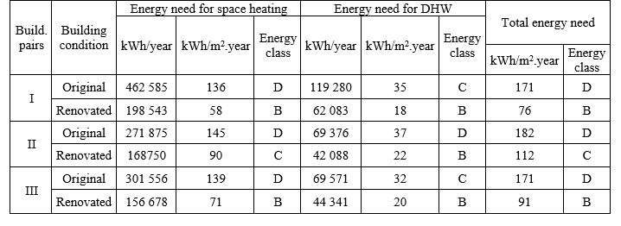
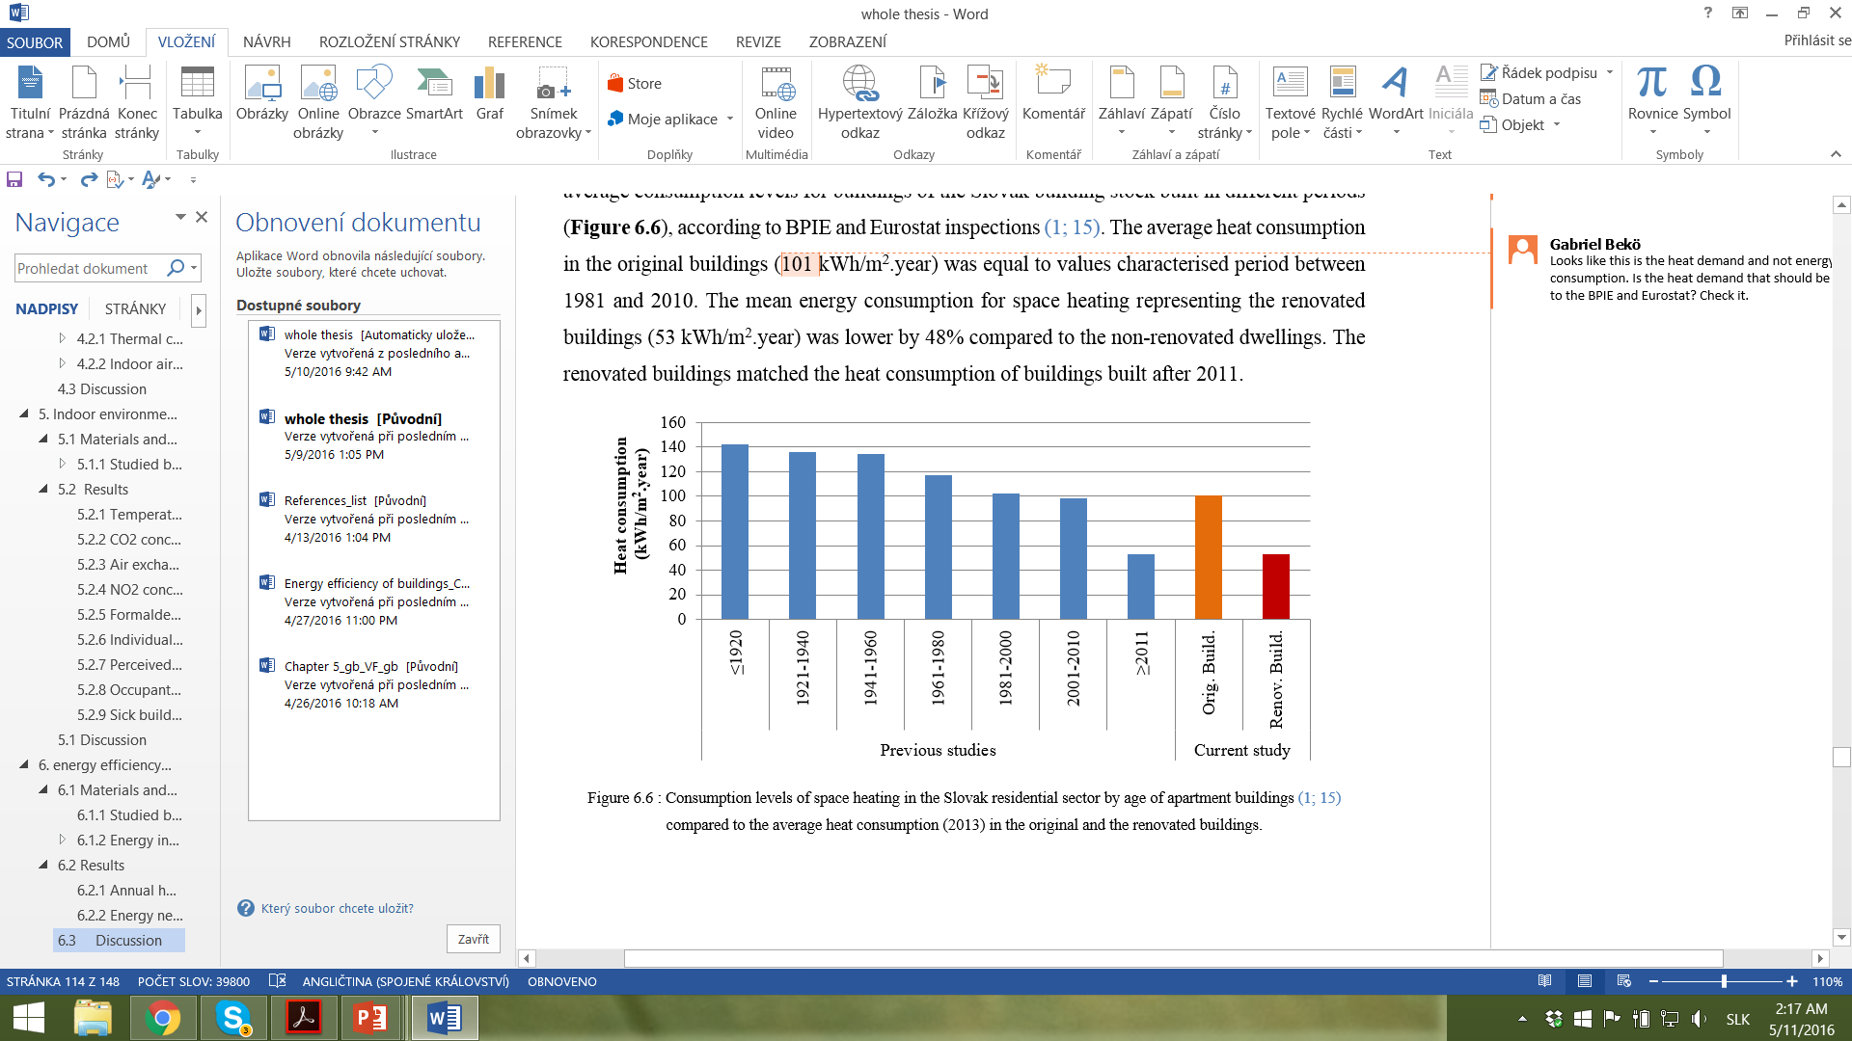
INTRODUCTION
MATERIALS AND METHODS
RESULTS
CONCLUSIONS

Slide 6
INTRODUCTION
MATERIALS AND METHODS
RESULTS
CONCLUSIONS
INDOOR AIR QUALITY

Slide 7
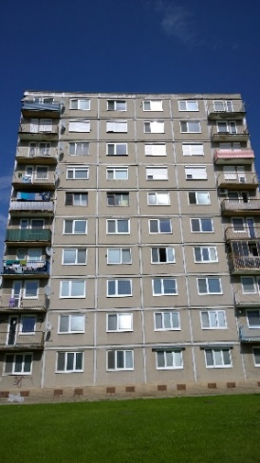
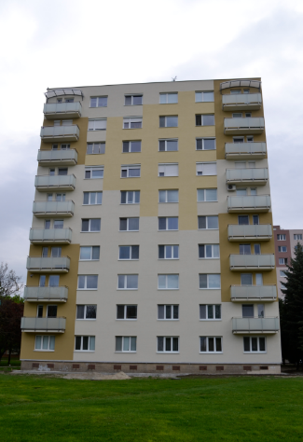
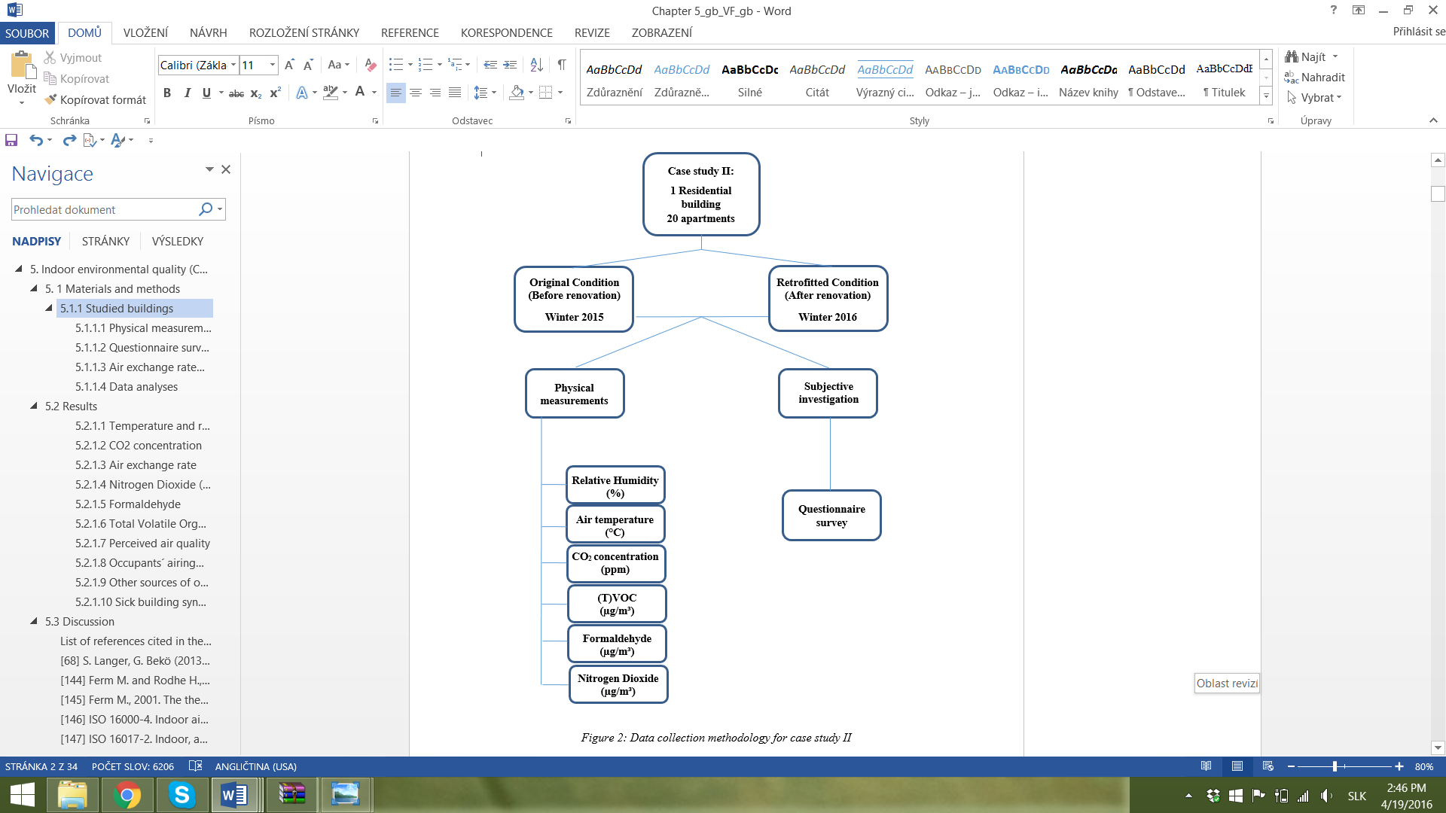
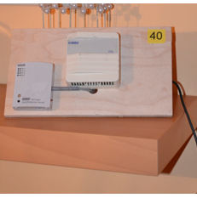
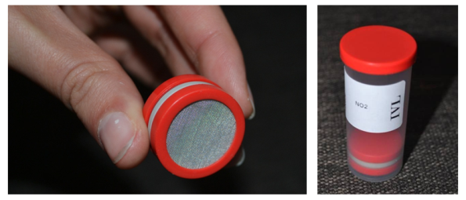
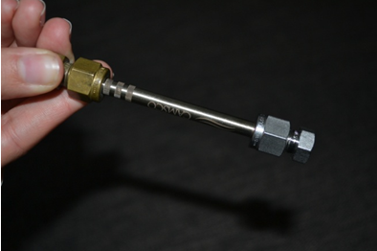
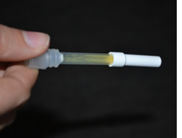
INTRODUCTION
MATERIALS AND METHODS
RESULTS
CONCLUSIONS
Data collection methodology

Slide 8
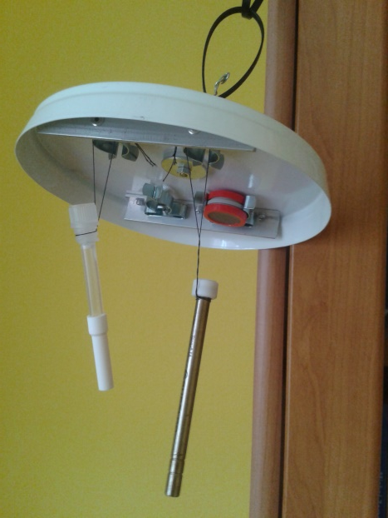
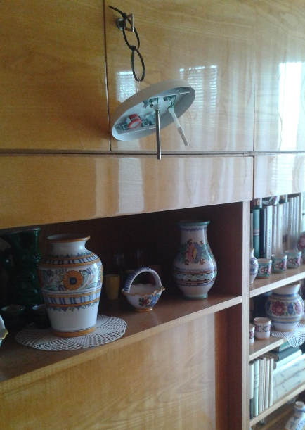
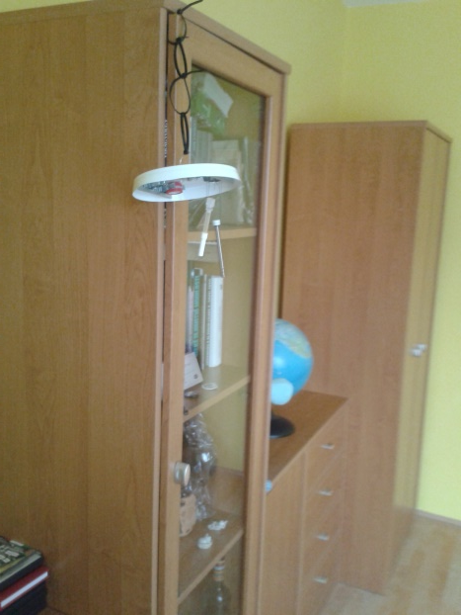
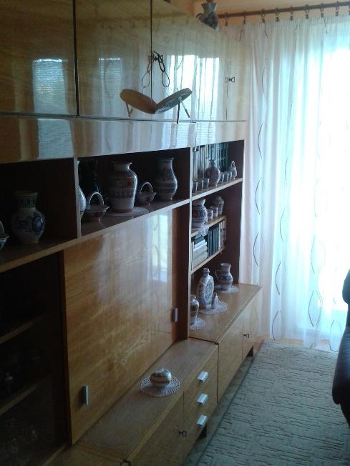
INTRODUCTION
MATERIALS AND METHODS
RESULTS
CONCLUSIONS

Slide 9
INTRODUCTION
MATERIALS AND METHODS
RESULTS
CONCLUSIONS
CO₂ concentration and AERs
p < 0.05
p < 0.01

Slide 10
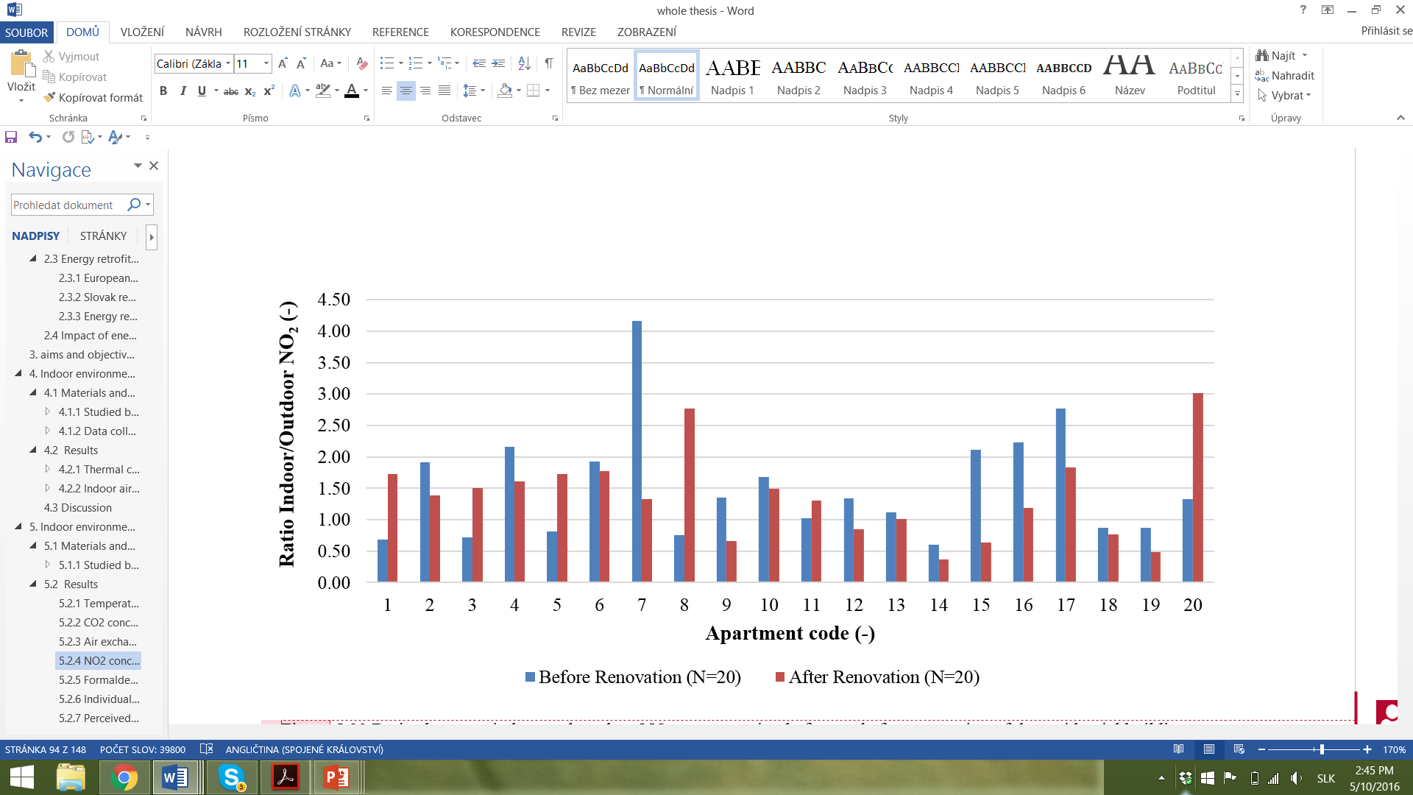
INTRODUCTION
MATERIALS AND METHODS
RESULTS
CONCLUSIONS
NO₂ concentration
p > 0.1
I/O ratio = 1

Slide 11
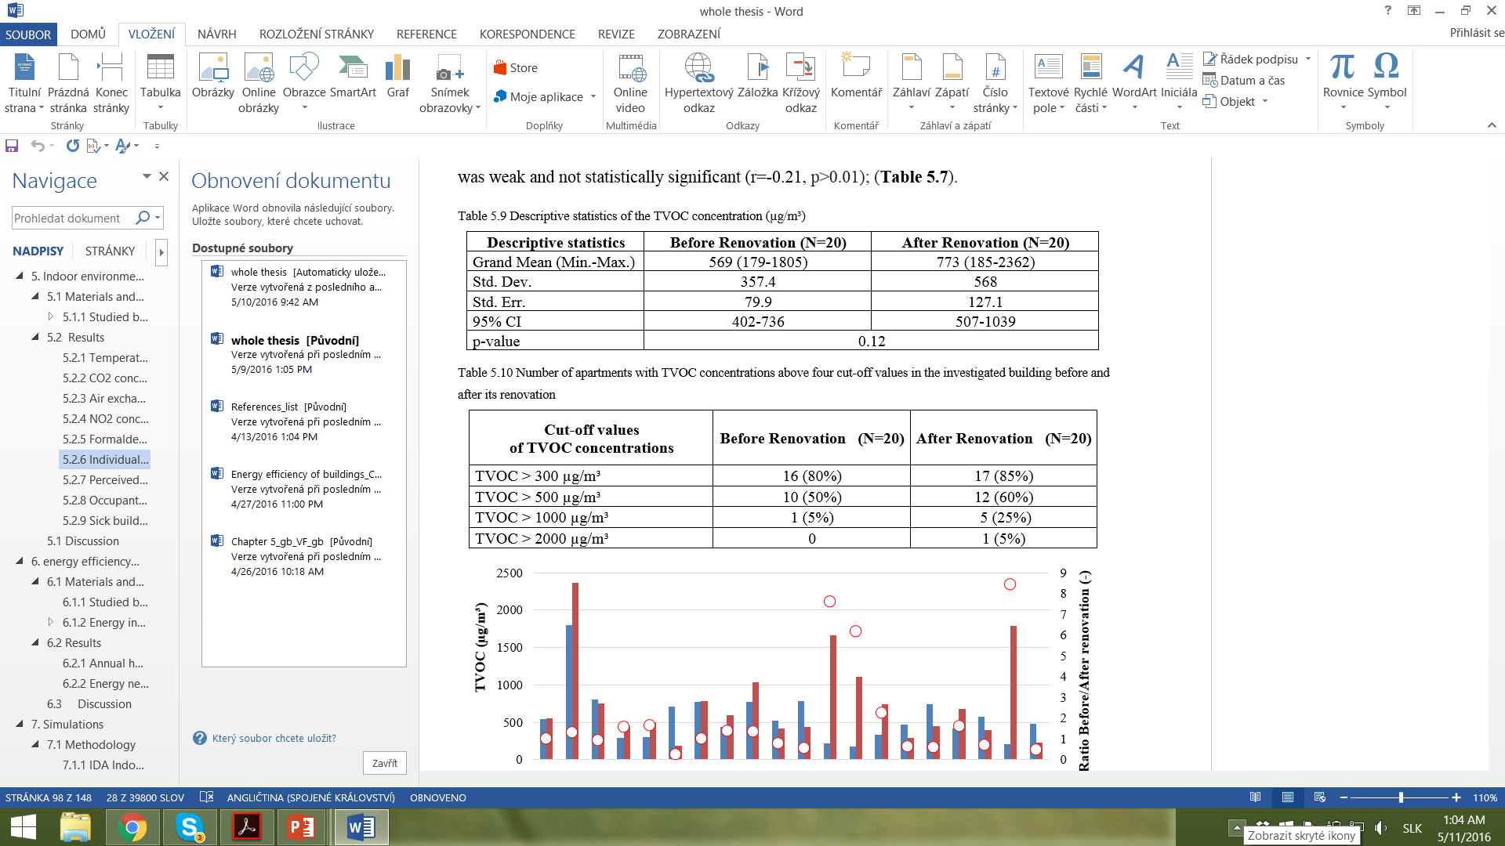
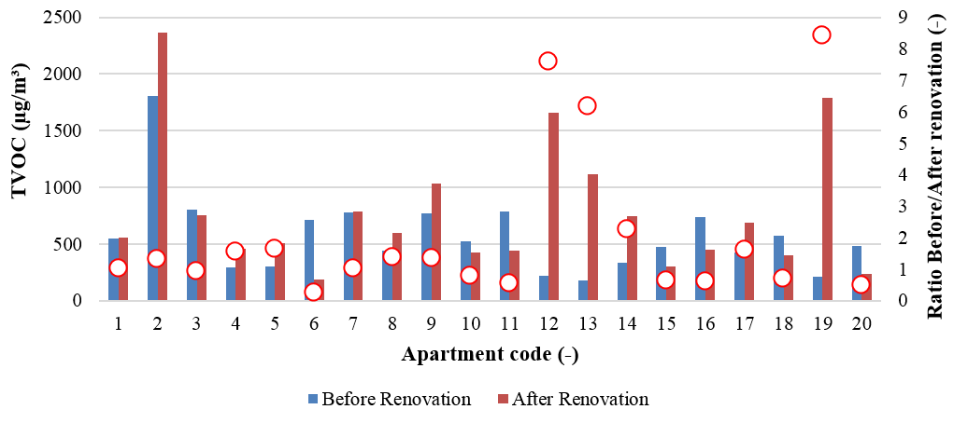
INTRODUCTION
MATERIALS AND METHODS
RESULTS
CONCLUSIONS
TVOC
0.1<p<0.15
7.6x
6.2x
8.4x

Slide 12
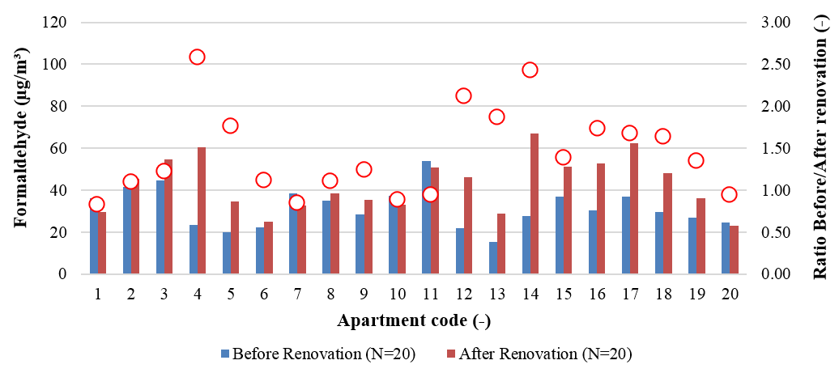
INTRODUCTION
MATERIALS AND METHODS
RESULTS
CONCLUSIONS
Formaldehyde
p < 0.01
The range of B/A where increase was observed (N=15):
1.09 and 2.5 (average ratio 1.62)
The range of B/A where decrease was observed (N=5):
0.82 to 0.94 (average ratio 0.89)

Slide 13
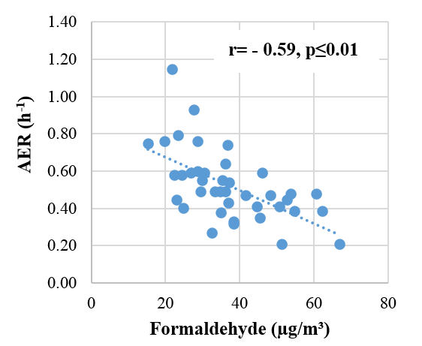
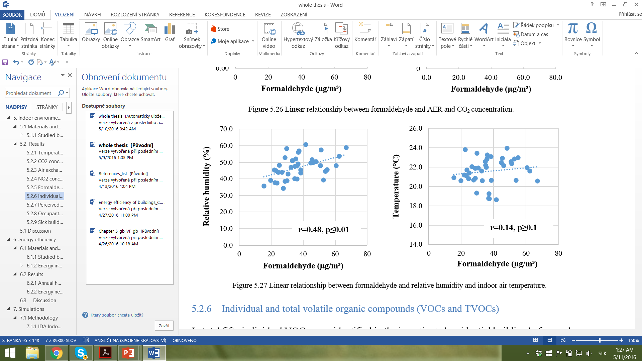
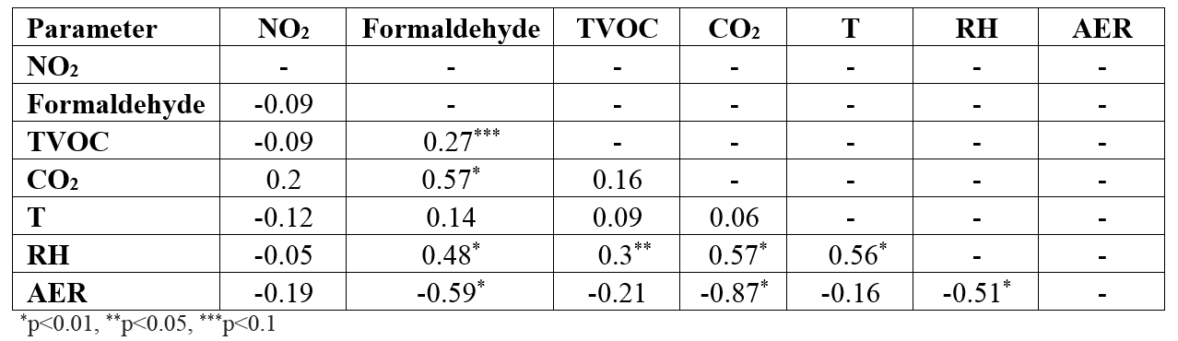
INTRODUCTION
MATERIALS AND METHODS
RESULTS
CONCLUSIONS
Correlations between the IAQ parameters
and concentrations of pollutants

Slide 14
INTRODUCTION
MATERIALS AND METHODS
RESULTS
CONCLUSIONS
Perceived air quality
p < 0.01
Positive correlation was found between AERs and acceptability (r=0.79, p<0.01).
Negative correlation was observed between formaldehyde concentration and acceptability (r=-0.53, p<0.01).

Slide 15
INTRODUCTION
MATERIALS AND METHODS
RESULTS
CONCLUSIONS
Occupants´ airing habits

Slide 16
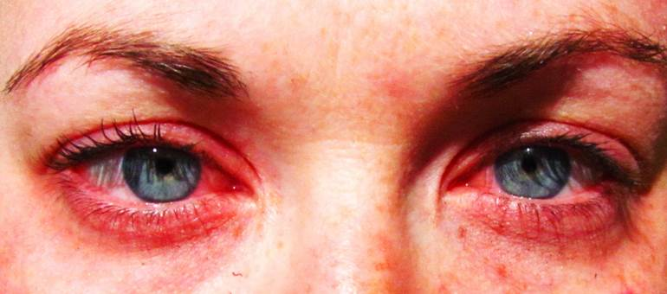

INTRODUCTION
MATERIALS AND METHODS
RESULTS
CONCLUSIONS
Sick building syndrome
Logistic regression
The dependent variable was binary:
(1- After renovation, 0 – Before renovation).
Stepwise forward and backward analyses: to identify predictor variables with inclusion criteria of p<0.2.
Parameter | Odd Ratio | P-value
Reference: Before renov. After renovation | 7.12 | 0.05
Parameter | Odd Ratio | P-value
Reference: Before renov. After renovation | 1.38 | 0.19

Slide 17
INTRODUCTION
MATERIALS AND METHODS
RESULTS
RESULTS
CONCLUSIONS
CONCLUSIONS
Case study II. – Key findings
The occupants indicated to be more satisfied with the indoor air quality before renovation
Significant, but modest positive correlation was found between relative humidity and formaldehyde.
NO₂ results indicate the presence of indoor combustion sources in some apartments.
The TVOC concentrations exceeded 300 µg/m³ (WHO, 2009) in a large fraction of the apartments before renovation already.
Significantly higher concentrations of CO₂ and formaldehyde were observed after renovation and both were strongly correlated with AERs.
Occurrence of SBS symptoms increased after renovation.

Slide 18
INTRODUCTION
MATERIALS AND METHODS
RESULTS
CONCLUSIONS
SIMULATION STUDY

Slide 19
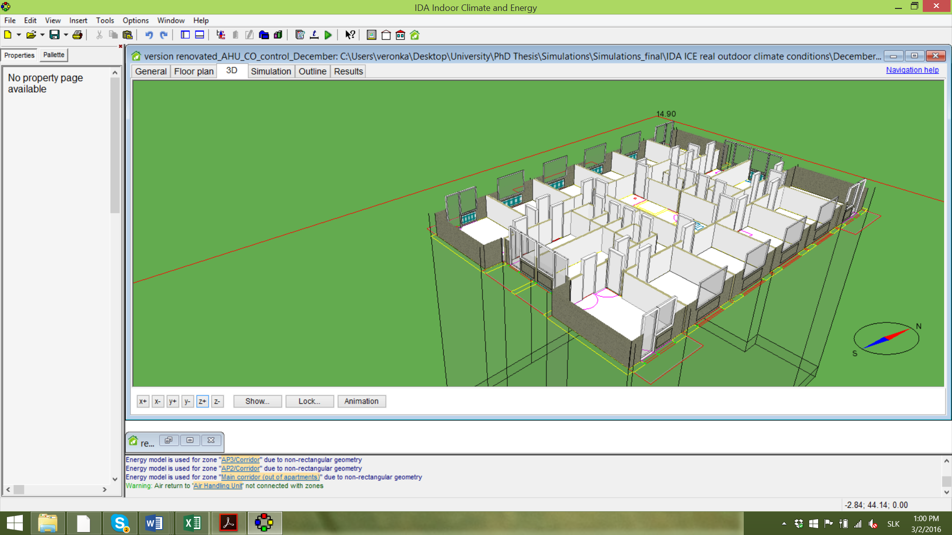
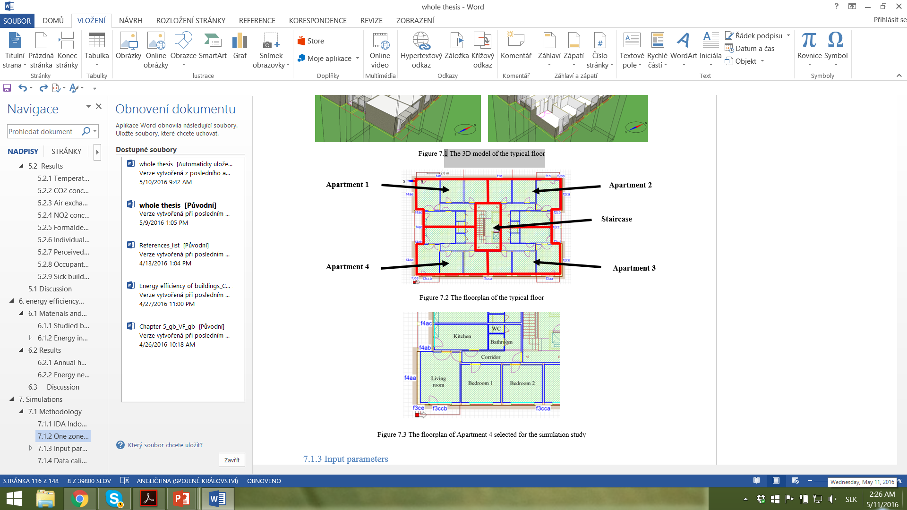
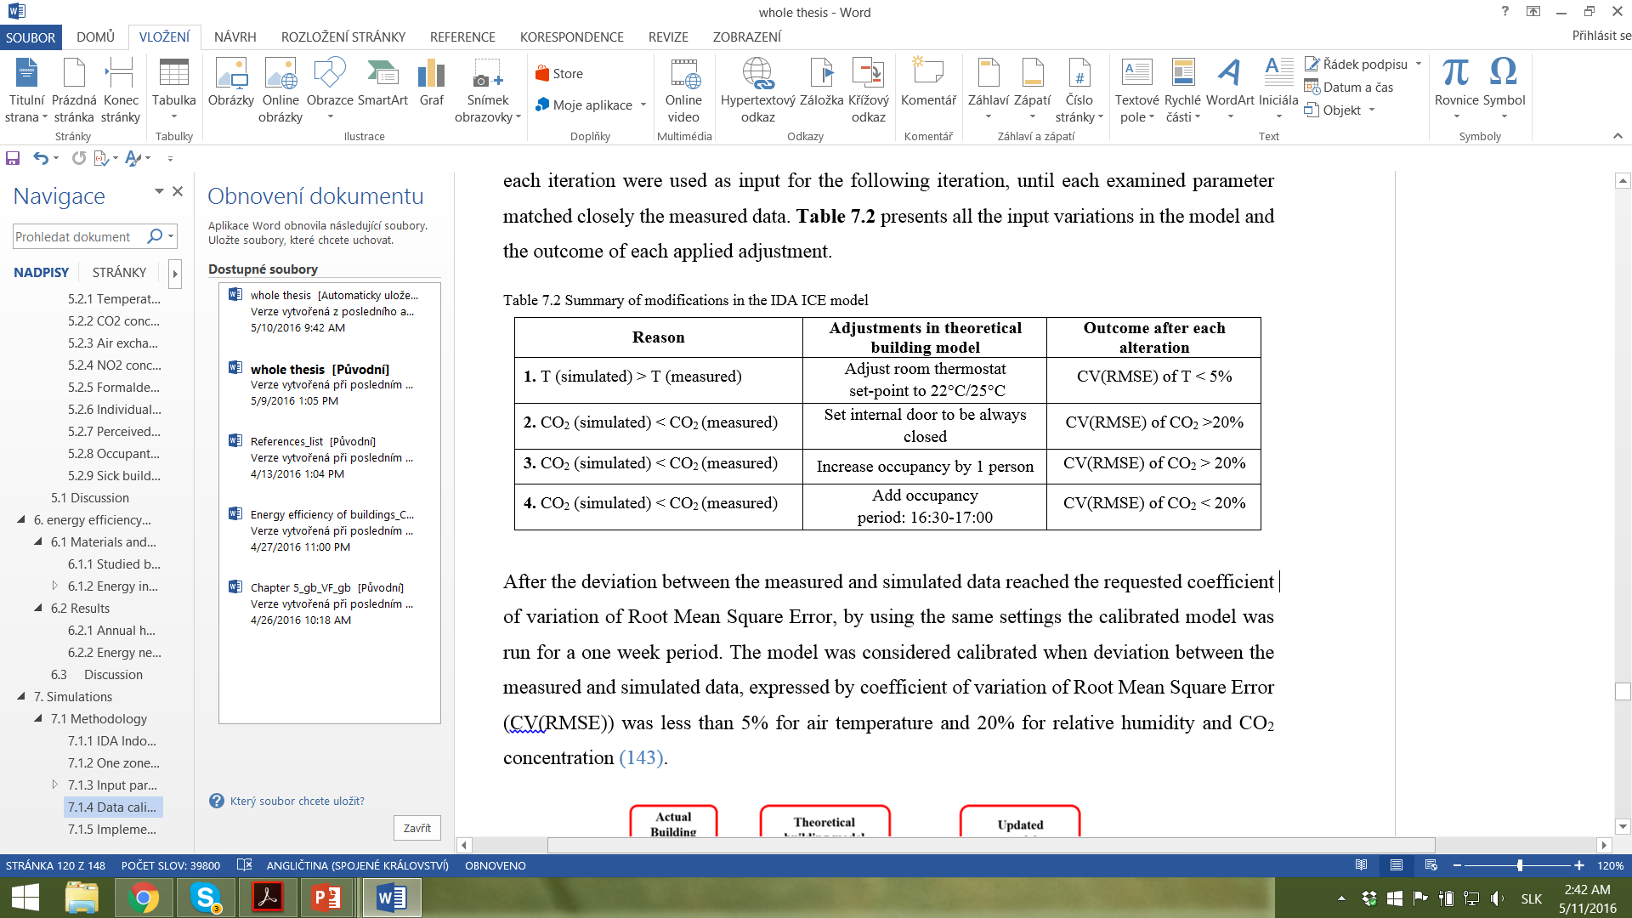
INTRODUCTION
MATERIALS AND METHODS
RESULTS
CONCLUSIONS
Simulation tool: IDA ICE 4.6.2 released in 2014
Investigated zone: Bedrom „1“
IEQ simulation model
Input parameters:
Weather data: period between 10-18 Dec. 2013
Real condition of building constructions
Real condition of building services
Data validation and calibration

Slide 20
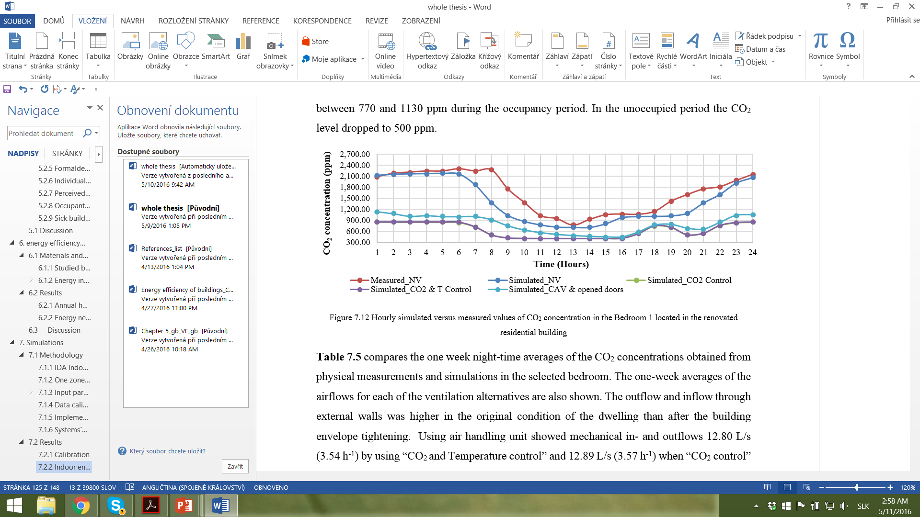
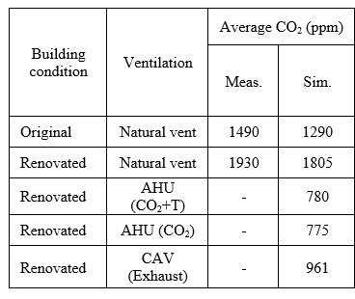
INTRODUCTION
MATERIALS AND METHODS
RESULTS
CONCLUSIONS

Slide 21
INTRODUCTION
MATERIALS AND METHODS
RESULTS
RESULTS
CONCLUSIONS
CONCLUSIONS
Simulation study – Key findings
The demand controlled systems with constant mechanical inflow and outflow resulted in a CO₂ concentration below 800 ppm in the zone.
Using exhaust fans (CAV) in the apartment ensured an average CO₂ concentration of 960 ppm in the investigated zone.
Using exhaust systems in kitchens and sanitary rooms, and at the same time keeping doors of the rooms open may be one of the a low-cost ventilation strategies, which is able to provide improved IAQ in energy-retrofitted buildings with minimal additional energy penalty.

Slide 22
Recommendations
When planning refurbishments, requirements for a healthy and comfortable indoor environment should be included. It should also be reflected in national renovation strategies.
In the national legislation, stricter energy performance requirements should be complemented by appropriate minimum requirements for ventilation in residential buildings.
IAQ indicators should be integrated in energy certification programs.
Economic benefits of healthy indoor environment should be considered in future renovation programs.

Slide 23
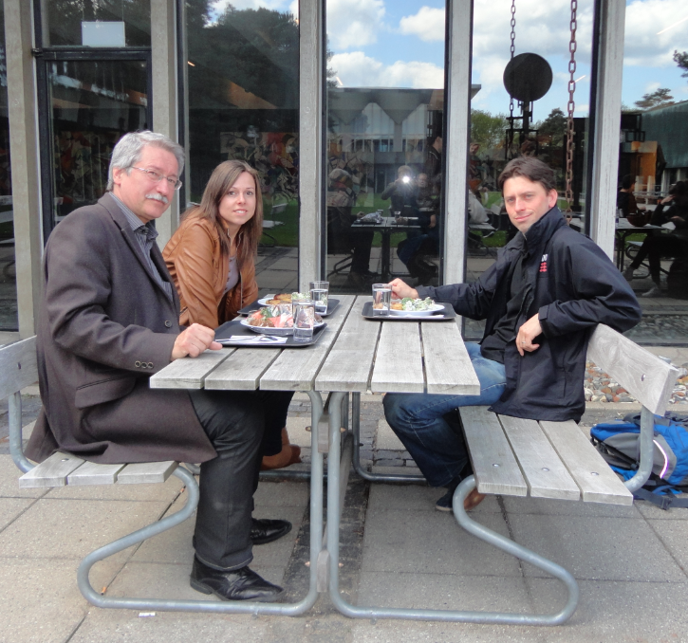


Acknowledgements
Jakub Kolařik
DTU Civil Engineering
Sarka Langer
Swedish Environmental Research Institute
Supervisors

